Slide 1
Hydrus
By J.A.C.K. Games
Jakob Miller, Aaron Scoble, Caleb Frasier, Kate Sullivan
Notes:
Hey everyone, thanks for coming out to see us today.
We are Jakob, Aaron, Caleb, and Kate
We’re J.A.C.K. games and we’re here today to show you our game project Hydrus
Hydrus is a first-person sci-fi real-time grid-based dungeon crawler with roguelike elements.
Set in an abandoned terraforming space station where something has gone very wrong.
Inspired by games like Legend of Grimrock, Vaporum, and old school dungeon crawlers.

Slide 2
Overview
Explore Areas
Collect Cores
Defeat Final Boss
Spawn into Hub Area
Explore connected areas
Defeat unique enemies and an area boss
Return to Hub
Primary resource
Dropped upon enemy death
Large amount gained from area bosses
All cores are lost upon death
Core Uses
Power up player abilities
Unlock Final Boss door
Entrance available from Hub Area
Requires a large number of cores
Game is cleared when boss is defeated
Notes:
From the hub area, the player can explore either two main areas.
After clearing an area, the player will be transported back to the hub, and can explore either area again.
Each area has unique enemies, and one unique area boss.
This process repeats until the final boss is defeated.
Cores can be collected by defeating area bosses and enemies.
Stronger enemies will drop more cores
Area bosses give the most cores.
Cores can be consumed to upgrade the player’s abilities, or, with enough, to unlock the door to the final boss.
All cores will be lost upon death
The final boss is unlocked after the player has collected enough cores to unlock the door in the main hub area.
After the final boss is defeated, the player wins and the game is over.

Slide 3
Game Layout
Final Boss
Boss
Boss
Boss Door
(Locked)
Biodome
Mechanical Bay
Spawn/Hub Area
Door
Door
Notes:
Two main areas - Transitional door from Hub area
Boss Door - Unlocked from Hub area
Transported back to Hub area after area boss defeated
Death - lose cores and transport back to hub

Slide 4
Level Layout
Boss
Locked Door
Static Room
Static Room
Key
Procedural Hallways
Procedural Hallways
Procedural Hallways
Static Room
Door
Notes:
From door, starting in static room.
Procedural maze-like hallways leading to other static rooms.
Key somewhere in the area, unlocks area boss door.
Area boss door leads to boss room and boss fight.

Slide 5
Combat and Movement Flow
Enemy
Enemy
-50
Enemy
E
Player
Q
-20
WASD
Notes:
First person, Grid-based real time movement and combat
Cooldowns, cast times, types and effects
Ability-based combat - Player 4 abilities, enemies 2 abilities, bosses 4 or more.
Ability Types
Self - Will affect the casting entity.
Melee - Will affect the tile directly in front of the casting entity.
Ranged - Will affect a tile within a predetermined amount of tiles in front of the casting entity.
Area of Effect - Will affect numerous tiles in a predetermined area relative to the casting entity.
Over Time - Will affect entities struck gradually over a specific duration.
Area of Effect over Time - Will apply effects to numerous tiles in a predetermined area relative to the casting entity. These effects will be applied to entities on these tiles periodically for a specific duration.
Ability Status Effects
Cast Time Slow - Affected entities have their cast times slowed for a specific duration.
Cooldown Slow - Affected entities will have longer cooldowns for abilities used while affected.
Stun - Affected entities are unable to take any actions for a specific duration.
Movement Slow - Affected entities take longer to move between tiles for a specific duration.
Root - Affected entities are unable to move between tiles for a specific duration. These entities can still use abilities and take other actions.
Silence - Affected entities are unable to use abilities for a specific duration. These entities can still move between tiles and take other actions.
Heal - Affected entities have a specific amount restored to their health over a specific duration. Entities cannot exceed their maximum health.
Haste - Affected entities will have quicker cast times for any abilities used during the effect.
Rage - Affected entities have their cooldowns lowered by a specific amount for a specific duration.
Damage Reduction - Affected entities take reduced damage from all sources by a specific amount for a specific duration.

Slide 6
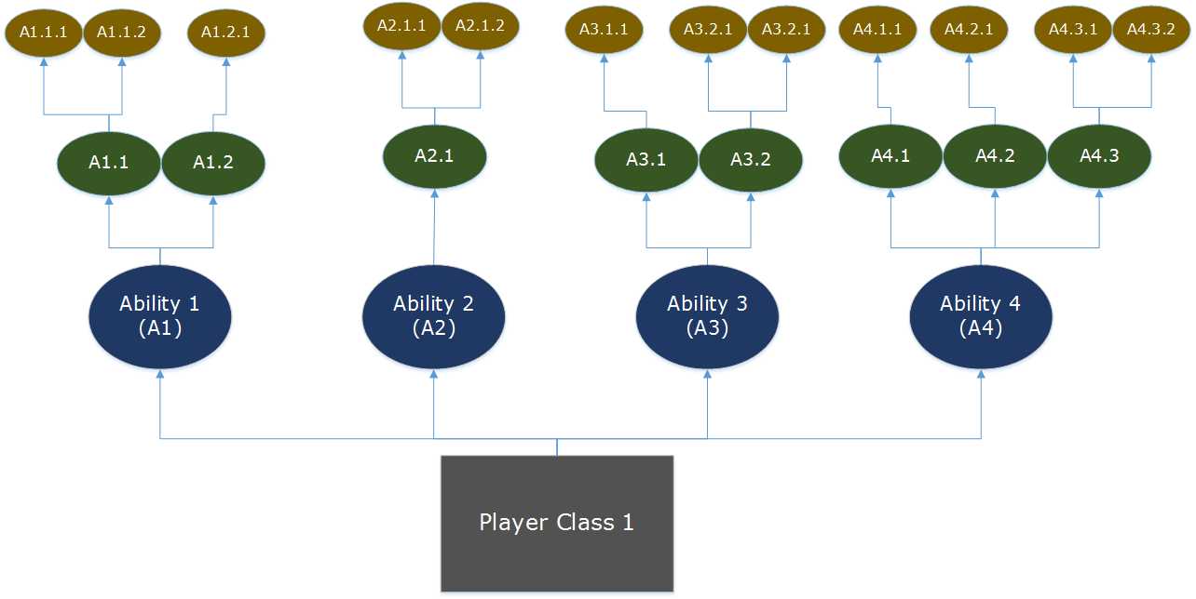
Player
Classes
Knight
Balanced Melee
Quick Melee
Damage Reduction Buff
Heal Buff
Marksman
Balanced Ranged
AoE Slow
Heal Buff
Balanced Melee
Tank (Stretch Goal)
Mage (Stretch Goal)

Slide 7
Enemies
Biodome
Flower Spider
DoT
AoE slow
Trilobite Beetle
Weak melee
Defensive buff
Alien Plant
Melee snare
Weak melee
Mind Control Insect
Team haste
Ranged silence
Mechanical Bay
Gardening Bot
Weak melee
AoE DoT
Medical Bot
Heavy DoT
Heavy debuff
Security Bot
Quick ranged
Heavy root

Slide 8
Bosses
Final Boss
Alien Parasite
Heavy Debuff AoE DoT
Slow, High Damage Line AoE
Self Heal
Melee Stun
Very High-Damage AoE
Slow Instakill
Biodome
Praying Mantis
Melee
Strong AoE DoT Slow
High Damage, Slow Melee
Low Damage, Heavy Stun
Mechanical Bay
Malfunctioning AI
Quick Ranged
High Damage, Slow AoE
Ranged Long-Duration Silence
Heavy, Slow DoT

Slide 9
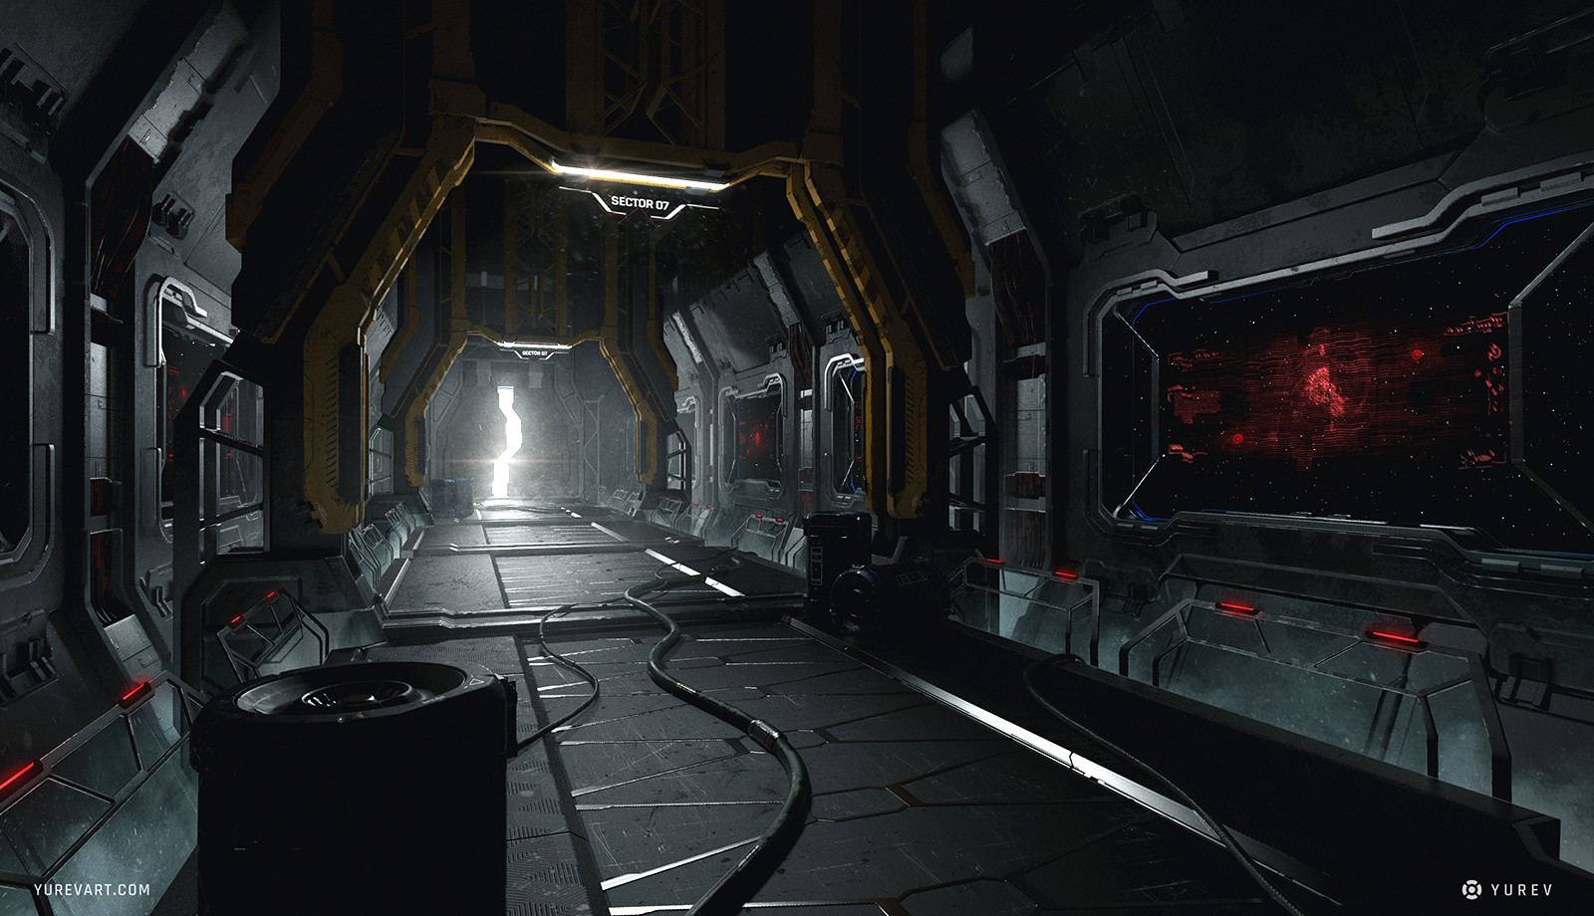
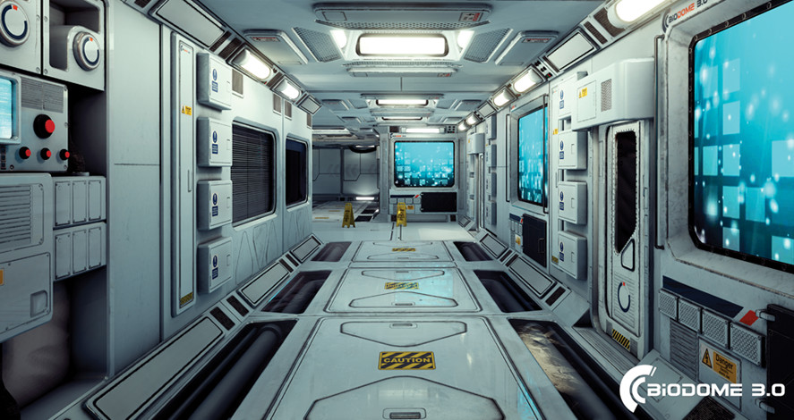
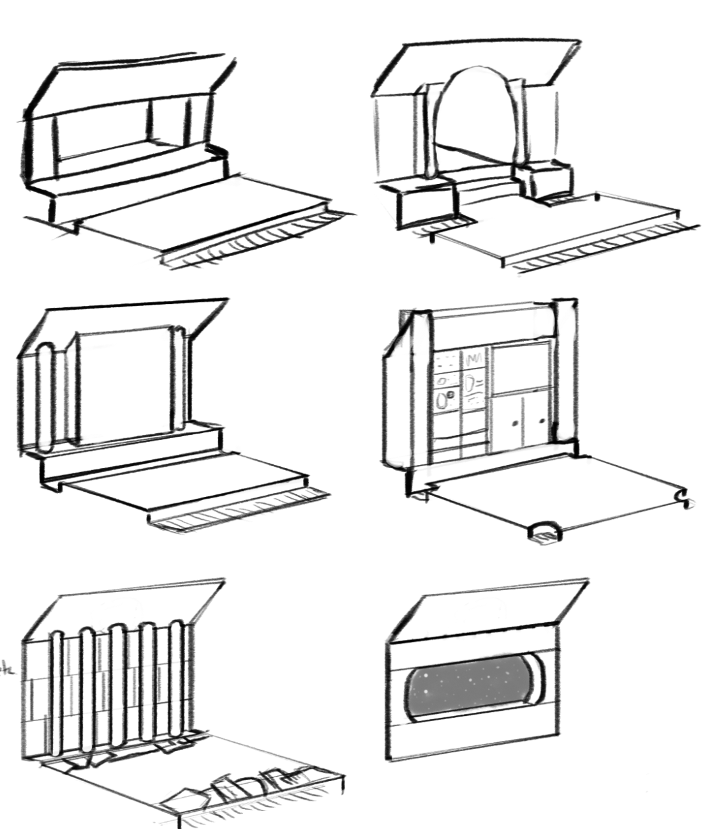
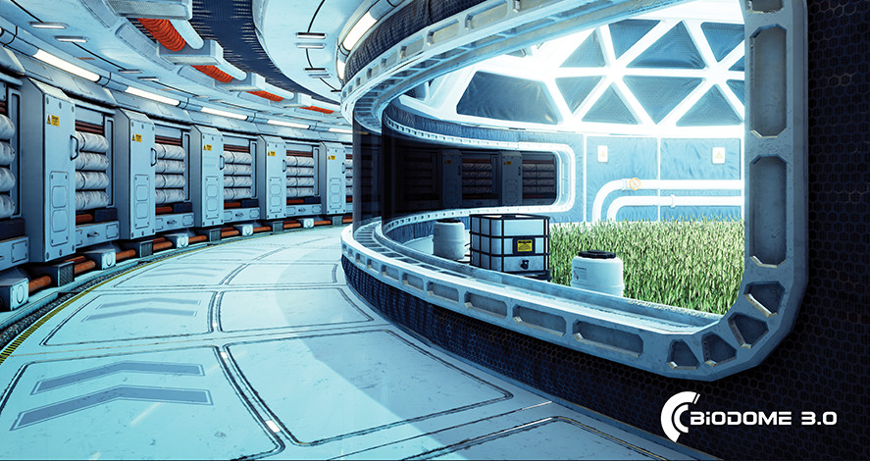
Visual Art
Notes:
Hydrus will be using assets generated from both Mudbox and Maya, allowing for high detailed uv mapping, while maintaining lower poly models. Animations and skeletons will be made in Maya, then imported into Unity. Models will have polycounts varying based on utility: Enemy models will hover within 10-30 thousand polygons, unless clustered. Environment models will fall within 300-800 polygons. Substance Painter and Designer will be used for Texturing of all models. Particle effects will be generated within Unity for abilities and enemy attacks.

Slide 10
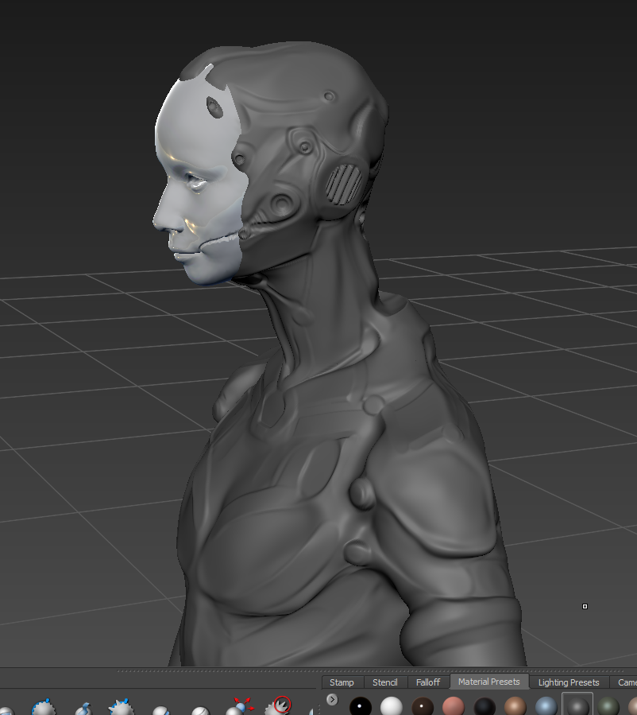
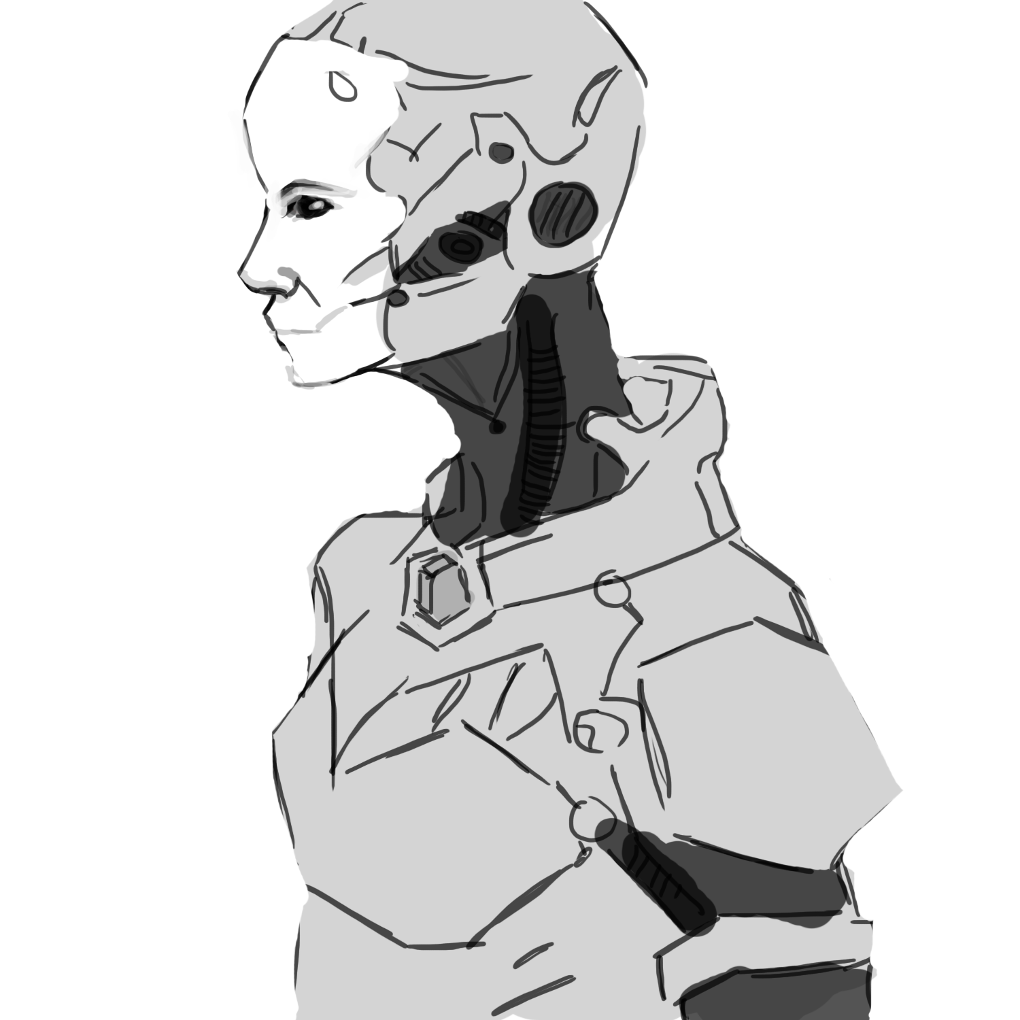
Visual Art
Notes:
The player is trapped on an abandoned space station orbiting a distant star 12 million light years away from Earth. Once a marvel of astro-engineering, the station has been reduced to dark, twisting hallways and forgotten rooms. Hints to the sad fate of the minimal human crew litter the station. With their overseers gone, the autonomous systems that once allowed Hydrus to thrive have instead mysteriously transformed into vicious anomalies that attack anything that moves.
The Biodome served as the primary source of nutrients and other organic resources for the inhabitants of the station. However, unchecked mutation has since resulted in a far more hostile environment filled with oversized flora and fauna.
The Mechanical Bay built, housed, and maintained the robots that performed the majority of basic tasks aboard Hydrus, from cleaning to security. Due to the harsh trials of time, or perhaps something more sinister, these formerly docile and elegant feats of engineering have become cold and dangerous machines.

Slide 11
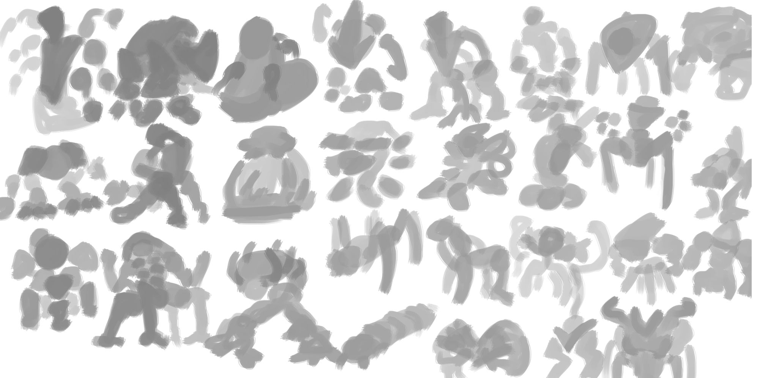
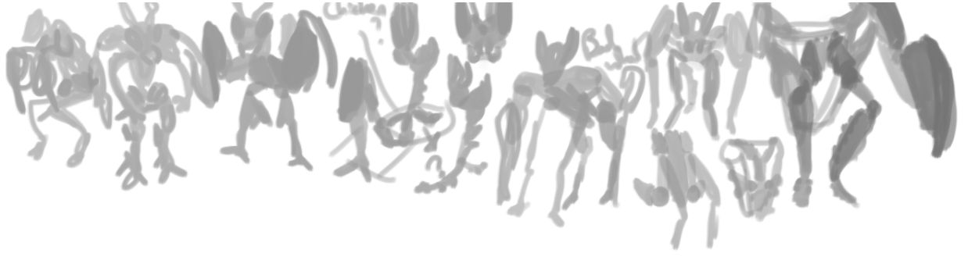
Visual Art
Notes:
The player is trapped on an abandoned space station orbiting a distant star 12 million light years away from Earth. Once a marvel of astro-engineering, the station has been reduced to dark, twisting hallways and forgotten rooms. Hints to the sad fate of the minimal human crew litter the station. With their overseers gone, the autonomous systems that once allowed Hydrus to thrive have instead mysteriously transformed into vicious anomalies that attack anything that moves.
The Biodome served as the primary source of nutrients and other organic resources for the inhabitants of the station. However, unchecked mutation has since resulted in a far more hostile environment filled with oversized flora and fauna.
The Mechanical Bay built, housed, and maintained the robots that performed the majority of basic tasks aboard Hydrus, from cleaning to security. Due to the harsh trials of time, or perhaps something more sinister, these formerly docile and elegant feats of engineering have become cold and dangerous machines.

